Slide 1




RUNTIME TERROR
Mentor name :
Dhananjay Kumar
Team members name :
1. Arjan Singh
2. Tarun Bawari

Slide 2
Approach
We have built an Angular Single Page application which communicates with a NodeJS server through a REST API. For face verification we have leveraged AWS Recognition.
Must Have:
Register patient with facial capture.
Upload prescriptions
Login, select a prescription and request fill.
Identify list of medicines which need identity check. For those which need, capture the picture of the user through the camera and validate if it is the registered patient.
Post the refill request if identification successful.
Additional Functionality:
Provide email notifications after admin verification and order completion.

Slide 3
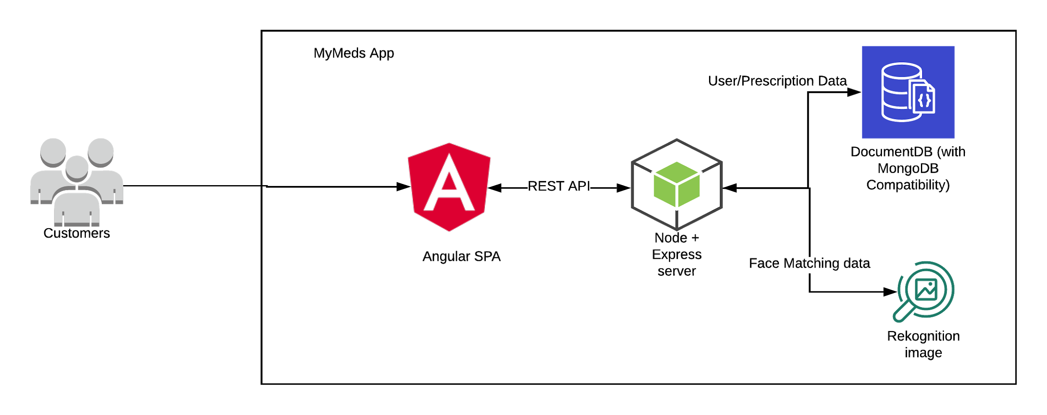
Architecture of Solution
Block Diagram
Technologies Used:
Angular(Frontend)
Node + Express(Backend)
Mongo DB(Database)
AWS(Face Matching)

Slide 4
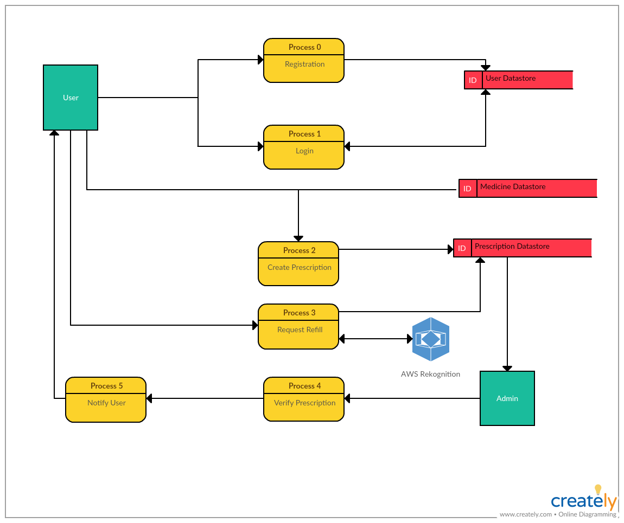
Data Flow Diagram

Slide 5
Assumptions
We assume that the user doesn’t use a photo instead of their face during face recognition.
Since it is made using Angular, it can be used on mobile phones using a browser to give a similar experience to desktop users.
Can be converted to a Progressive Web App, but benefits will be small since application requires internet to function.

Slide 6
Thank You!

